Slide 1

Convolutional Neural Network (CNN)
Artificial Intelligence

Slide 2
Introduction
One of the best method for image analysis in deep learning
Consist of input layer, hidden layer and an output layer

Slide 3
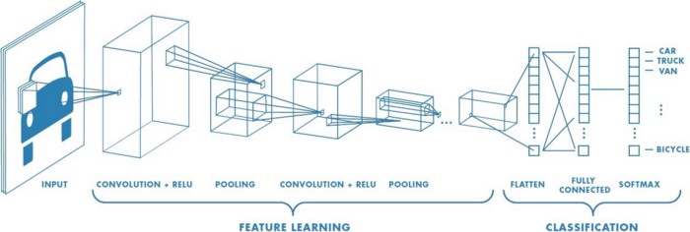
Source: https://towardsdatascience.com/a-comprehensive-guide-to-convolutional-neural-networks-the-eli5-way-3bd2b1164a53

Slide 4
Convolution layer (CONV)
Source: https://analyticsindiamag.com/convolutional-neural-network-image-classification-overview/

Slide 5
Pooling layer
Source: https://github.com/daviddwlee84/DeepLearningPractice/blob/master/Notes/Element/Layers.md

Slide 6
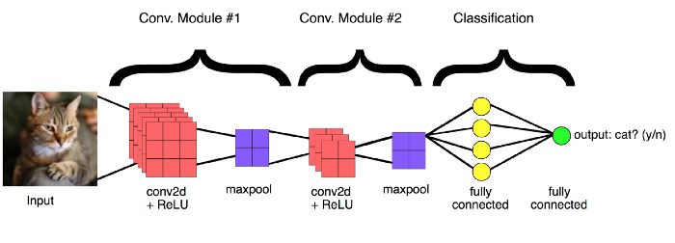
CNN basic structure
Source: https://towardsdatascience.com/introduction-to-convolutional-neural-network-cnn-de73f69c5b83

Slide 7
Application of CNN
Image classification
Object detection
Image segmentation
Binary class
Multi-class

Slide 8
Thank you!

